Slide 1
Lesson 5.3
Applications of Rational Functions: Work Rates, STD’s, and Round Trips

Slide 2
Work Rates:
When solving work rate problems, the fractions represent that percentage of work that each worker completes
The denominator of each fraction is how much time it takes each person to complete the job alone
The numerator is the amount of time they each worked, usually the unknown
The sum of the fractions is how much they completed, 100% = complete
Ie: Jim, Tom, and Shirley work together to complete a job.
If they work alone, Jim will take 5 hours, Tom will take 6 hours, and Shirley will take 7 hours
Jim and Tom both worked 1 hour more than Shirley
half the job?
How long will it take them to complete the job together?
Jim
Tom
Shirley
+
+
=
100%

Slide 3

Ex: Mike can mow his lawn alone in 2h. His brother Tim do the same job alone in 4h. Their sister Susan can do the job alone is 15 hours. How long will it take if they work together?
% of Mike’s Work:
% of Tim’s Work:
% of Susan’s Work:
It will take them 1.27 hours if they work together

Slide 4
Together, Larry, Karen, and Stew can do a job in 72minutes. Individually, Larry takes an hour longer than Stew, and two hours longer than Karen.
a) How long does it take Larry to do the job by himself?
b) What percentage of the job does each person do?
c) If Karen started 15 minutes late, how long will each person need to work?

Slide 5
Speed Time Distance Problems
Most STD problems involve two vehicles traveling the same distance at the different speeds
The speeds of each vehicle are given as comparisons, so set the speed of one them (slower vehicle) as the variable ‘x”
Always create a STD chart, write the “time” as a function of “Distance” over “speed”
Write your equation using the “time column”
Ex: A car can travel 500km at a speed 25km/h faster than a bus. If car uses 20 minutes less, how fast did each vehicle travel?
Bus’
Time
Car’s
Time
Write the time in HOURS

Slide 6
Ex: Jack and Steven are both leaving Portland for Bellingham (300km). Jack is taking the plane and Steven is driving. If Jack travels 10 times faster and requires 4.5 hours less, how fast is each person travelling?
Practice: Jack and Steven are both leaving Portland for Vancouver (500km). Jack is driving a Bugatti that travels on average 25km/h faster than Steven’s Tesla. How fast is each person driving if Jack arrives in his Bugatti 50.5 minutes earlier than Steven?
b) If the Bugatti will take 45minutes longer than the Tesla at the border crossing and travels only 15km/h faster than the Tesla, how fast will it need to travel to get there at the same time?

Slide 7
Practice:
Jack and Steven are both leaving Portland for Bellingham (300km). Jack is taking the plane and Steven is driving. If Jack travels 10 times faster and requires 4.5 hours less, how fast is each person travelling?
Equation:
Gather
Information
Difference in
time is 4.5h
Solve for “x”

Slide 8
Appl. #2) Travelling Questions w/ Different Speeds
These questions involves 2 or more different vehicles of transportations, ie: Car, bike, plane, spaceship….
A car can travel 400km 8 times faster than Tom. Tom needs 4.5 hours more than the car. How fast can Tom run?
Create a chart with S, T, D (always make a chart!)
Distance is usually the same
The difference in time is 4.5 hours
Tom’s time minus Car’s time is 4.5h
Solve this equation for Tom’s running speed!

Slide 9
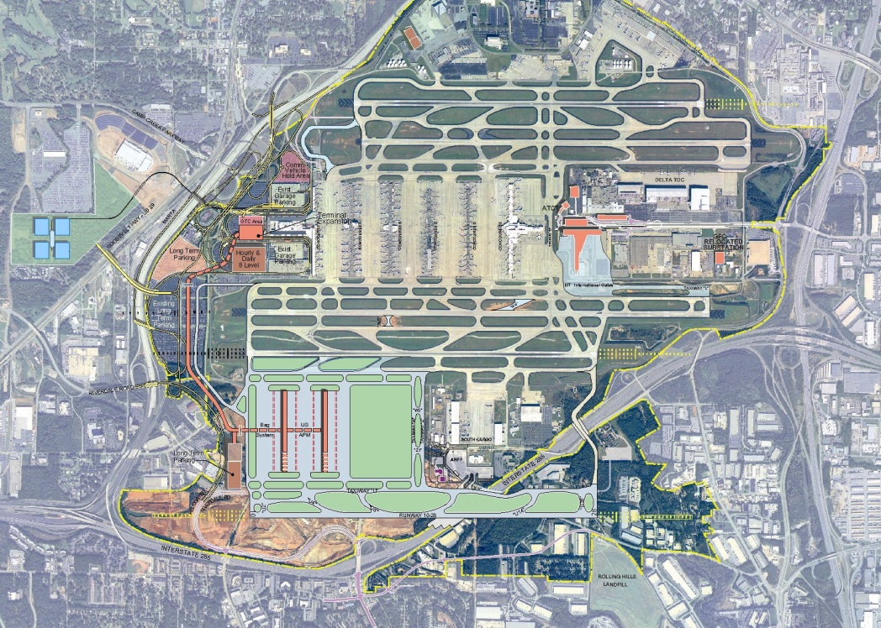

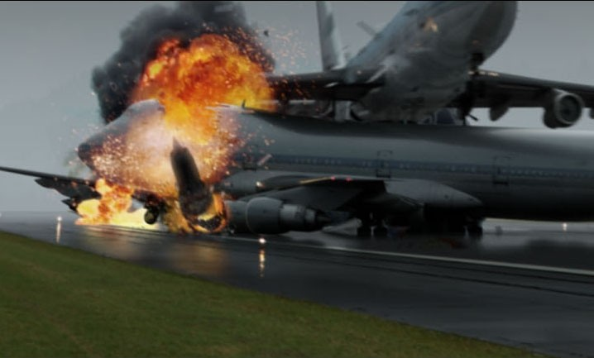
Appl #3: Plane Questions with wind Speed
This is the most important application in this chapter
Many international airports schedule over a million flights a year → 1.9 flights every minute
It is important that flights arrive/depart roughly on time
One uncontrollable factor is wind speed
Head wind → Wind is coming from ahead, slowing you down, decreases your speed
Tail wind → Wind is coming from behind, increasing your speed
For these questions, always make a chart using STD and let “x” be the windspeed if it’s not given
Time required for a round trip means the total time needed to go there and come back
Hartsfield-Jackson Atlanta International Airport

Slide 10
EX: The distance from Vancouver to Toronto to is 3400KM. A plane travels to Toronto with a tail wind and on the way back with a constant head wind with the same wind speed. a) Find an equation for the total time of a round trip.
B) If the wind speed was 50km/h how fast must the plane fly to complete a round trip in 9hours?
Gather Information
Equation:

Slide 11
b) How fast must we fly to arrive within 9 hours?

Slide 12
Ex: The flight distance from Vancouver to HK is 10300km. If the wind speed is 60km/r, how fast must a plane fly if a round trip will take 25hours?

Slide 13
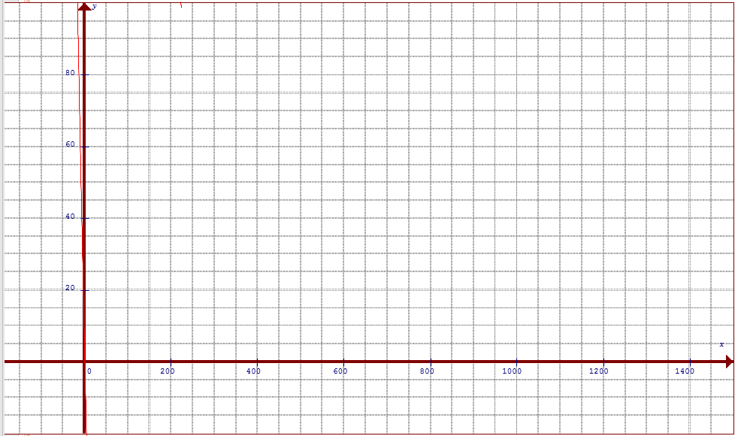
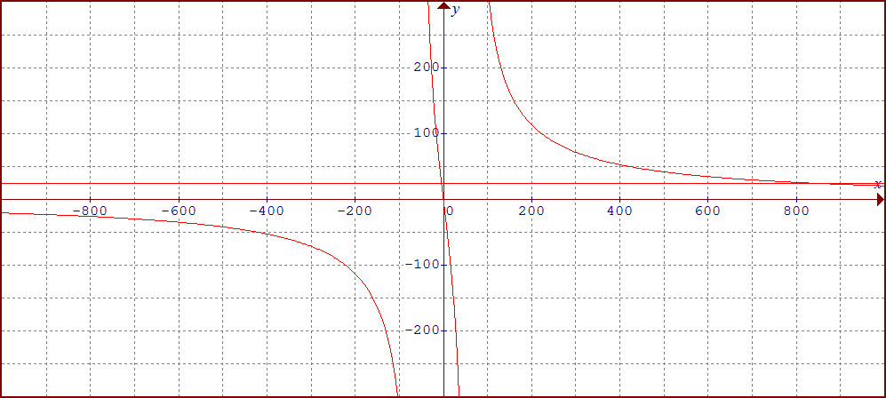
This graph shows the time required for a round trip (y) as a function of the plane speed (x)
Time
Speed

Slide 14
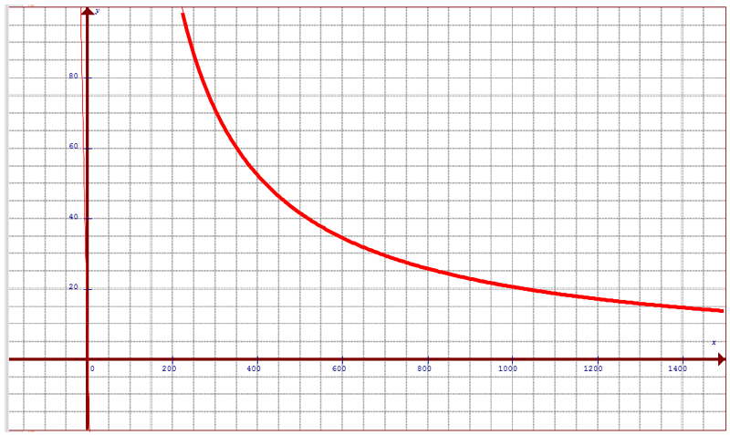
Use the Graph to Answer the following Questions:
Q: How long would the round trip take if the plane flew at 1200km/hr?
Q: How long would the round trip take if the plane flew at 1400km/hr?
What would happen if the plane only flew at 60km/hr?
What if the plane could travel at the speed of light. How long would it take to arrive at it’s destination?

Slide 16
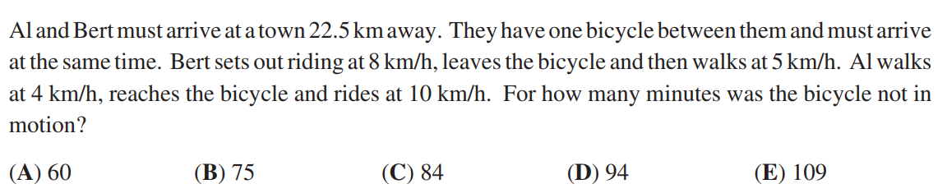

Slide 17
1st step: Make a chart
 | Distance | Speed | Time
Ero
Jamal
How much more time did Jamal needed more Ero?
So Jamal’s time subtract Ero’s time will be 2 1/3 hours
Now solve this equation

Slide 18
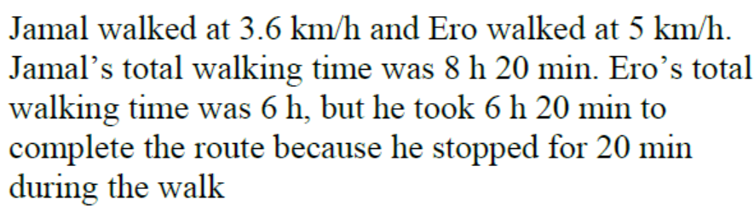
Find the LCD: 3(x)(x+1.4)
Multiply all terms by the LCD to get rid of the denominator
Use the QF or Factor
Can’t have a negative speed

Slide 19
1st step: Make a chart
 | Distance | Speed | Time
Arshia
Sarah
Arshia’s break was 30 minutes, so she had 30 minutes less time to travel
She also arrived 15 minutes later, so needing 15 minutes more to finish
Overall, she had 15minutes less than Sarah, that’s ¼ hours

Slide 20
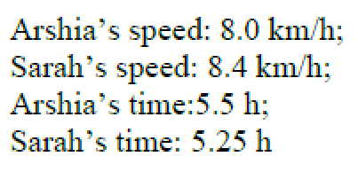

Slide 21
1st step: Make a chart
 | Distance | Speed | Time
Up Stream
Down Stream
Total time was 16 hours
Now solve equation!!

Slide 22
The speed of the current is 5km/hr

Slide 23
1st step: Make a chart
 | Distance | Speed | Time
Up Stream
Down Stream
Total time was 6 hours
Now solve equation!!

Slide 24
John was rowing at 6km/hr

Slide 25
1st step: Make a chart
Profit = Revenue - Expense
 | # of Shirts | Cost per Shirt | Total Amount
Expense and Cost
Revenue Sales

Slide 26
Jaime sold 18 shirts

Slide 27
1st step: Make a chart
 | Number of Days | Cost per Day | Total Amount
Original Plan
Actual Plan

Slide 28
Stuart expected to finish the job in 12 days. However, he ended spending 16 days to finish the job

Slide 29
ROUND Trip Flight Problems
There are many applications of rational functions that are not taught anymore if PC11
One important application of R.F. is anything that has to do with speed, time, and distance (STD)
When travelling by plane, car, or train, knowing how time can be affected by your change in speed
Vehicles have “optimal fuel efficiency”, to travel faster means burning more fuel → reduce time, increases cost
Another application is the effect of drag, windspeed, headwind vs tailwind
Speed, Time, Distance (STD)

Slide 30
Application#1: Rate of Work Problems
Rate of Work problems are usually about 2 or more people working together to complete a task
Ie: To paint a house alone, Sam would need 4 hours, Tim 6 hours, and Sara 5 hours. How long would it take for them to paint it together?
Think of these problems as percentages, each person does their part (percentage) to complete the job (100%)
Inside each box is a fraction that represent how much each person completes
Let “x” be the time that it takes to complete when working together
Sam
Tim
Sara
100% means that the job is complete
+
+
=
100%
The denominators are the individual times when working alone
Solve this equation for “x”

Slide 31
Solve for “x”
Hint: Look for values of “x” that can make this equation easier….
Ie: if x = 0, we get an answer…..
Hint #2: How can we make this equation easier to work with????
Since we know that x = 0 is an answer, what can we do to the “4” on the right??
Make this substitution for “x” and then move it to the right

Slide 32
Your equation now becomes easier to solve…
From this point, it’s brute force!!!!

